Slide 1
Introduction and Principles of Data Visualization

Slide 2
Learning Objectives
What is data visualization?
What are the components in data visualizations?
What are the principles of figure design?
What are the techniques for implementing visualizations?

Slide 3
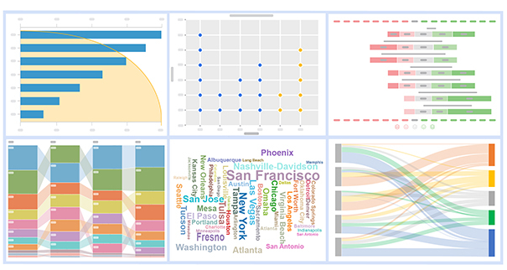
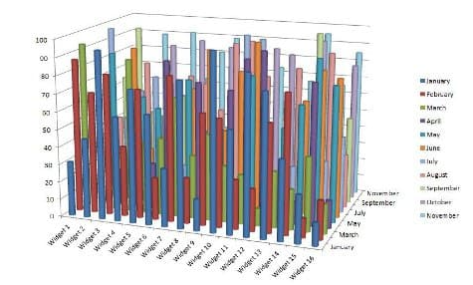
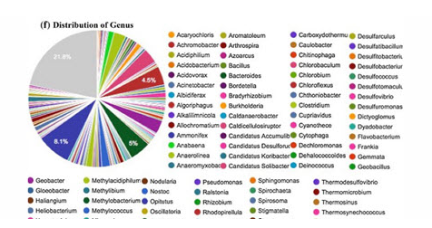
What is data visualization?
Convey data accurately
Convey data effectively and should be aesthetically pleasing
Notes:
Sometimes, it does not only require these visualizations to convey information accurately and effectively, it may also require them to highlight or emphasize particular message we want to convey in the data.

Slide 4
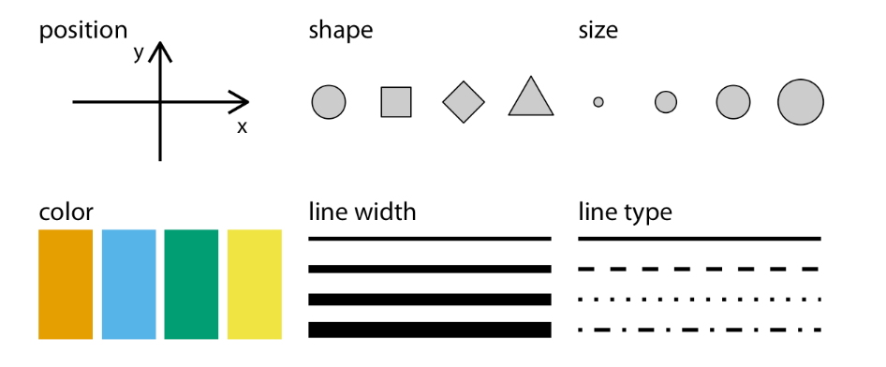
Visualizing Data: Mapping data onto aesthetics
All data visualizations map data values into quantifiable features in the resulting graphs.
Commonly used aesthetics in data visualization: position, shape, size, color, line width, line type. Some of these aesthetics can represent both continuous and discrete data (position, size, line width, color) while others can usually only represent discrete data (shape, line type)
Notes:
Whenever we visualize data, we take data values and convert them in a systematic and logical way into the visual elements that make up the final graphs.
Even though there are many different types of data visualizations, such as scatter plot, a pie chart, and a heatmap.
And these data visualizations seem to be really different, but one thing in common is that All data visualizations map data values into quantifiable features in the resulting graphs.
In terms of different positions of data points, different shapes of data, and different size of data according to specific values, and most often we also use color to indicate different categories of data or use color to emphasize some data
Similarly for the line width and line type
.

Slide 5
Visualizing Data: Mapping data onto aesthetics
According to the data types we use different visualization easthetics
Continuous data are values for which arbitrary fine intermediate values exist, such as time, student learning scores
Position
Size
Color
Line width
Discrete data are values for indicating different categories or levels
Shape
Line types

Slide 6
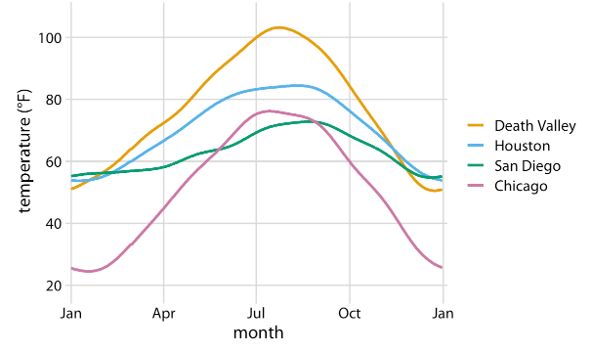
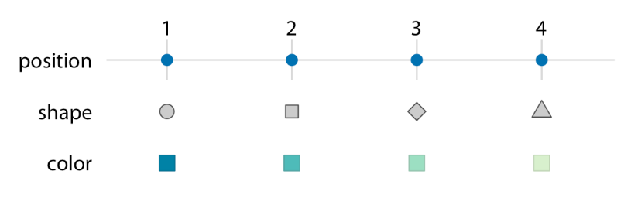
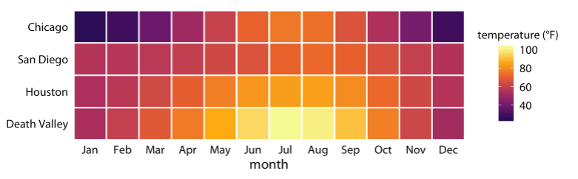
Visualizing Data: Mapping data onto aesthetics
Data values can be mapped as positions, shapes, and colors
Different ways to compare temperatures of four places in different months
Notes:
Line chart use the locations of the points to indicate the temperature in different month, color differentiate the places.
Heatmap use color to indicate the average temperature in each place at each month.

Slide 7
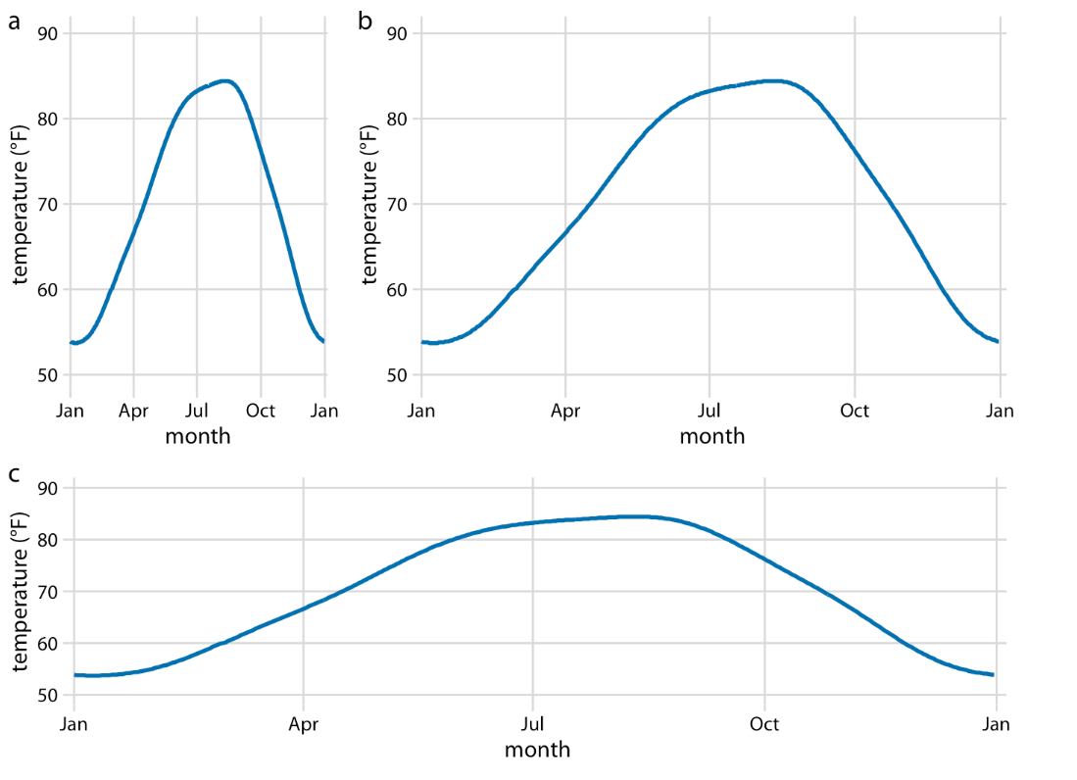
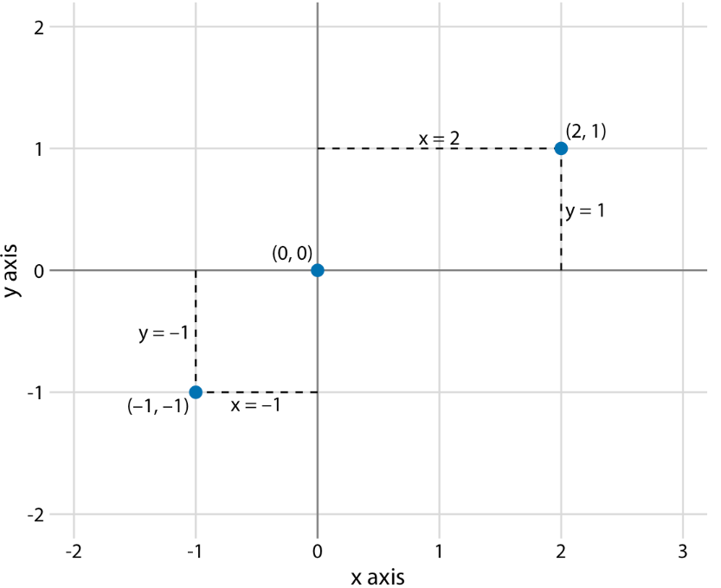
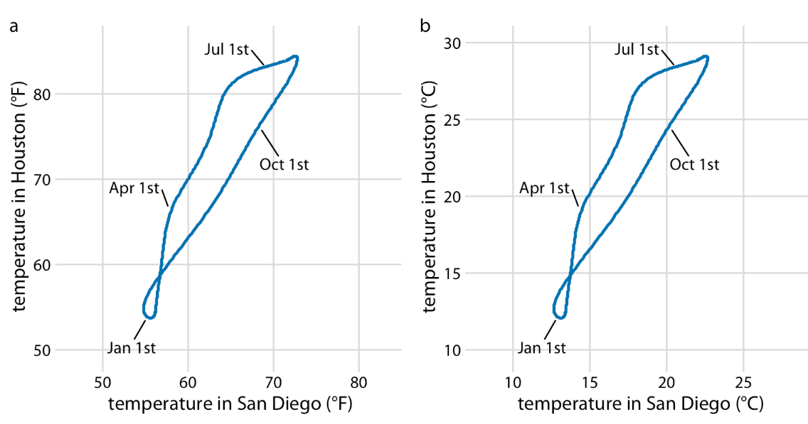
Coordinate systems and axes
Cartesian Coordinates
Two axes with different units, the spaces should be chosen to highlight important features.
Two axes with the same units, the spaces should be the same
Standard cartesian coordinate system
Notes:
Besides the aesthetics of data visualization, coordinate systems are another aspects we should consider carefully to visualize effectively and accurately.
The most commonly used coordinate system is 2d Cartesian Coordinate system, where each location is uniquely specified by x and y values.
Even though it is simple, one commonly overlooked aspect is the unit of values. If we have different units for x and y axis, we can shrink or extend one axis relative to the other one to emphasize different aspects in the data values.
For example, shrink x-axis can emphasize changes along y axis, if we shrink y axis, we can emphasize changes in x axis.
However, if the x, y are using the same units, then the grid spaces should be the same along these two axes.
Cartesian coordinate systems are invariant under linear transformations. Which means, you can change the units of your data and the resulting figure will not change as long as you change the axes accordingly.

Slide 8
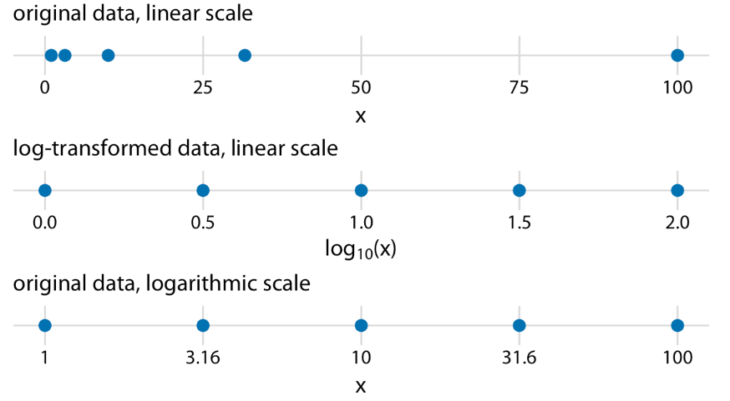
Coordinate systems and axes
Nonlinear axes
1 = 10^(0)
3.16 = 10^(0.5)
10 = 10^(1)
31.6 = 10^(1.5)
100 = 10^(2)
10^(x)
Notes:
Linear axes means the grid lines are spaced evenly both axes, and in the visualization results.
There are some scenarios that nonlinear scale works better.
This figure presents the differences between linear and nonlinear scale in visualization.
Nonlinear scale to visualize the original data, each space is represented by 10 exponential of something

Slide 9
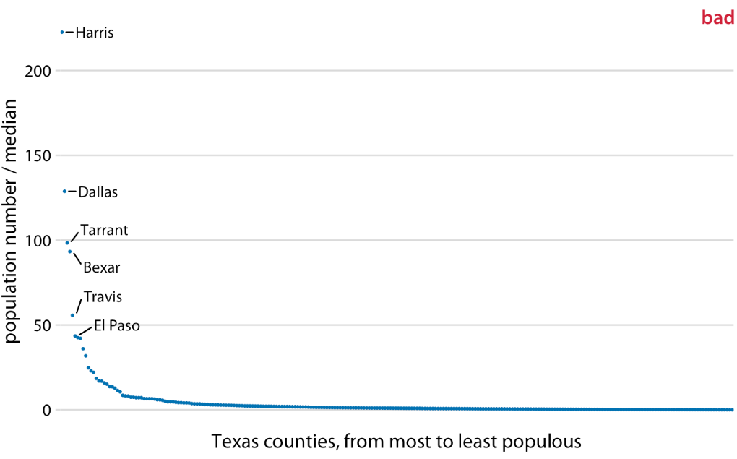
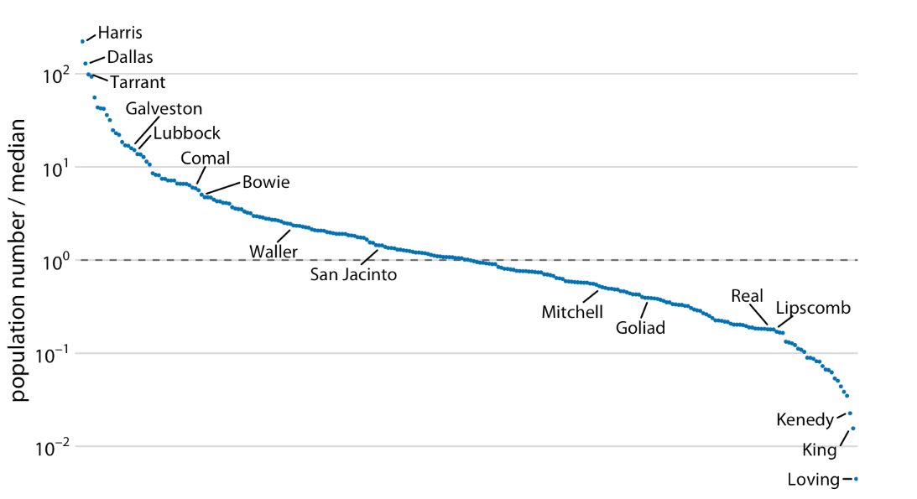
Coordinate systems and axes
Logarithmic scale is more appropriate for ratio
Population numbers of Texas counties relative to their median value
Notes:
Sometimes, log-scale is very useful in visualizing data with huge variance.
The first figure shows the ratio on a linear scale, we have overemphasized ratios > 1 and have obscured ratios < 1.
The second shows the ratio on a log-scale, line equals 1 indicates the county has the same number of population as median value
As a general rule, ratios should not be displayed on a linear scale.

Slide 10
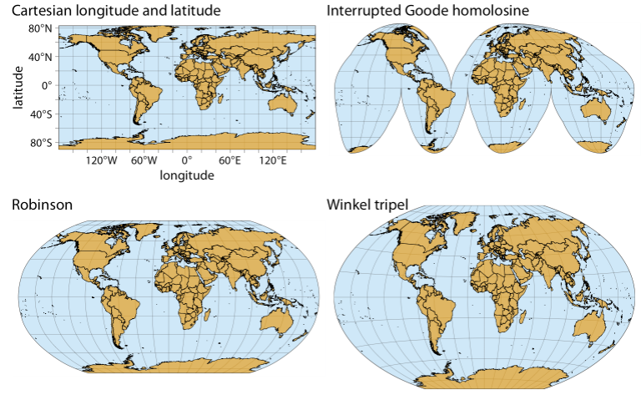
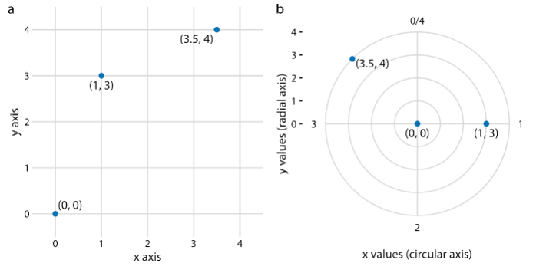
Coordinate systems and axes
Coordinate systems with curved axes
Relationship between Cartesian and polar coordinates
Geospatial data
Notes:
There are also coordinate systems with curved axes, such as polar coordinates, and in the settings of visualizing geospatial data, which is not very commonly encountered in scientific research and very easy to implement, so we will not spend much time on this.

Slide 11
Color scales
Three fundamental use of colors:
Using color to distinguish groups of data from each other
Using color to represent data values
Using color to highlight data
Notes:
We use colors for a purpose not just as we always use for the sake of coloring. Actually, there are three fundamental use of color in data visualization:

Slide 12
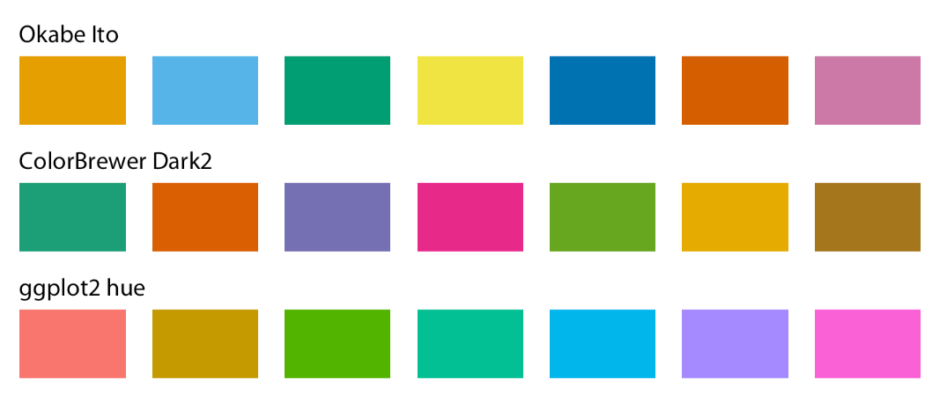
Color scales
Qualitative color scale as a tool to distinguish
Colors can be used to distinguish discrete items or groups that do not have an intrinsic order.
Qualitative color scales do not create the impression of an order.
Examples of qualitative color scale
Notes:
For distinguishing data from different groups or different individuals, we use qualitative color scale. One thing we should keep in mind is that there is not impressions of order.

Slide 13
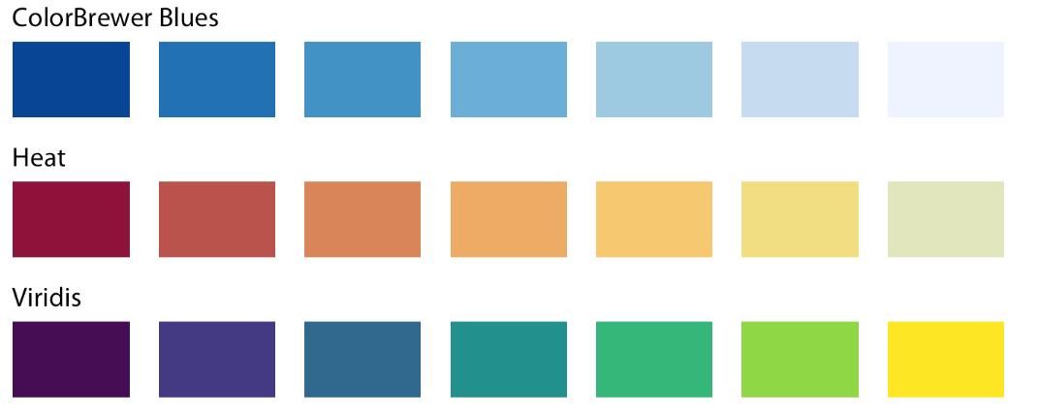
Color scales
Sequential color scales to represent data values
Colors can also be used to represent data values, such as income, temperature, or speed.
Such values clearly have: (1) which values are larger or smaller; (2) how distant two values from each other
Example sequential color scales

Slide 14
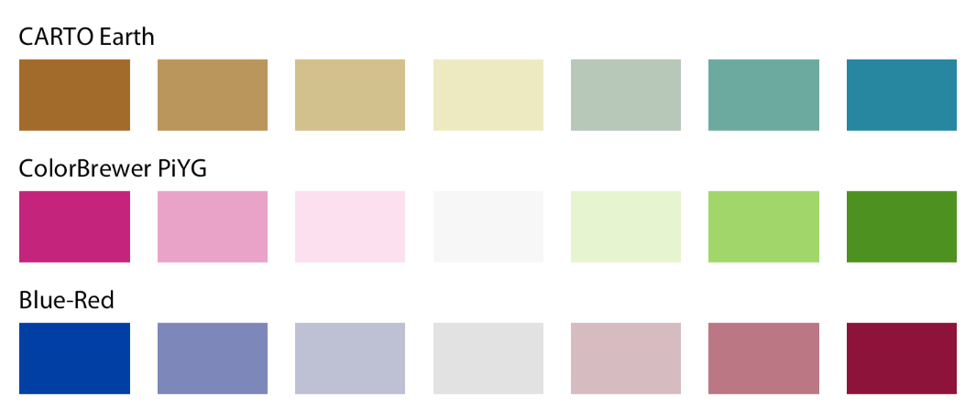
Color scales
Diverging color scales to represent data derivations
Colors can be used to visualize the derivations of data values in one of the two directions relative to the midpoint.
Diverging scales need to be balanced, so that the progression from light colors in the center to dark colors on the outside is approximately the same in either direction.
Example diverging color scales

Slide 15
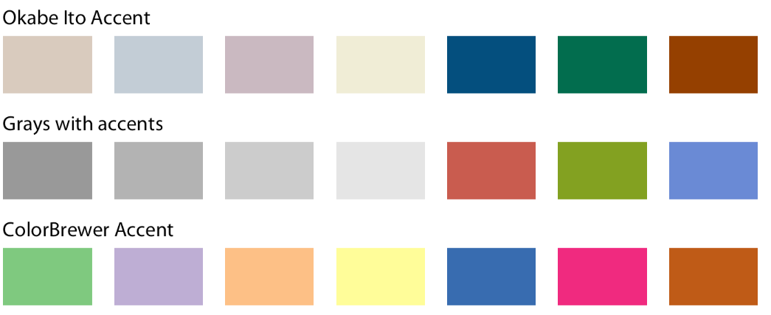
Color scales
Accent color scales to highlight specific values in data
When we use accent colors, it is critical that the baseline colors should not compete for attention. Often times, it is easy to make baseline colors too colorful, this may end up competing for the readers’ attention against the accent colors.
Example accent color scales, each with four base colors and three accent colors
Notes:
There is an easy remedy, however. Just remove all color from all elements in the figure except the highlighted data categories or points.

Slide 16
The principle of proportional ink
The sizes of shaded areas in a visualization need to be proportional to the data values they represent.
Notes:
Now, we have the basic knowledge in terms of how to map data into various elements on a graph, such as positions, shapes, sizes, colors.
The use of different coordinate systems
The use of colors
In this section, we analyze several generated visualizations to understand to do or not do in the actual visualization.
In visualization,

Slide 17
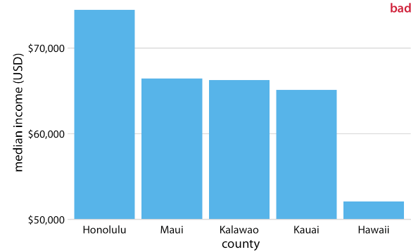
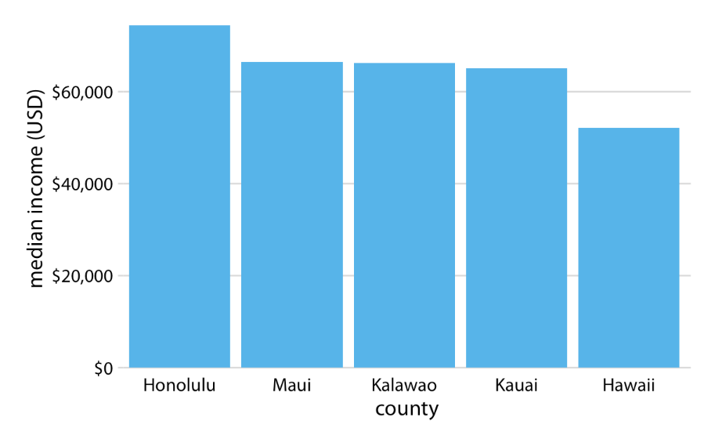
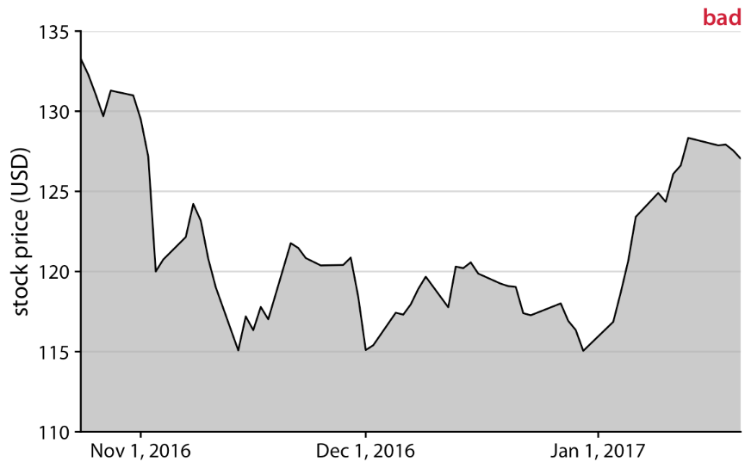
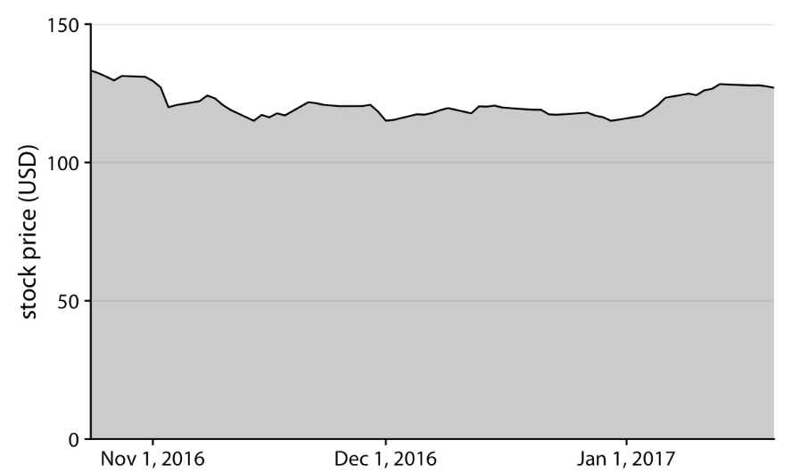
Misleading Bar Charts
Bars on a linear scale should always start at 0.
Notes:
Sometimes, visualization can be misleading, when we use inconsistency visualization strategies.
Look at these two figures, the first figure compares the differences in median income among five counties in Hawaii. And the second figure shows the changes of stock prices of facebook during a certain period of time.
What can you find from the figures?
Do you think these figures are problematic?
Even though the ending points of the bars represent the median income of each counties, the heights of the bars are quite misleading representing different meanings: the extent to which the median incomes exceed $50,000, which is an arbitrary number. And human perception is that the bar height is the key quantity we perceive when looking at this figure, not the location of the bar endpoint relative to the y axis.
Similarly, The area chart starts at $110, which will highlight the relative changes in price to $110. And further conveying a really misleading information that there had been significant changes in stock prices during the period. However, it is not really the truth when we see the overall figure.
Especially, the filled part in the figure emphasize the distance from the location of the x axis to the specific y values in the figure, creating an visual impression that height of filled part is the actual stock price of the specific day.

Slide 18
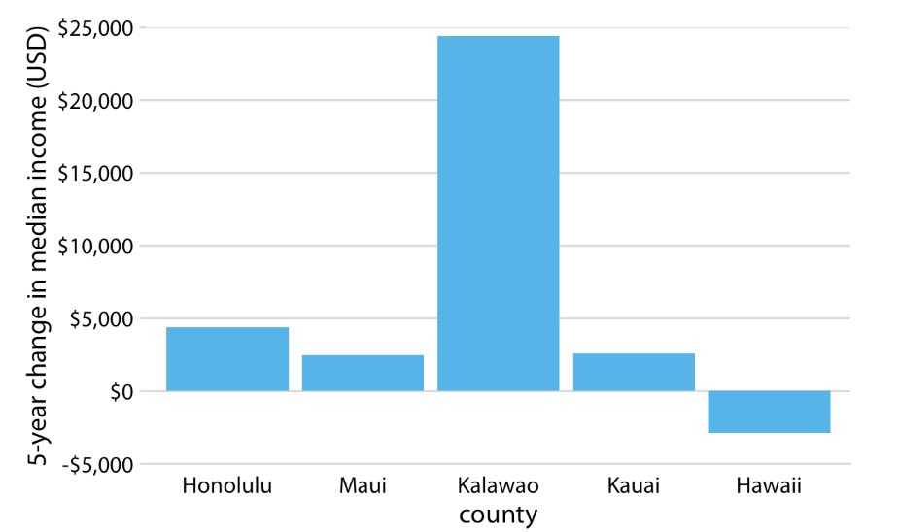
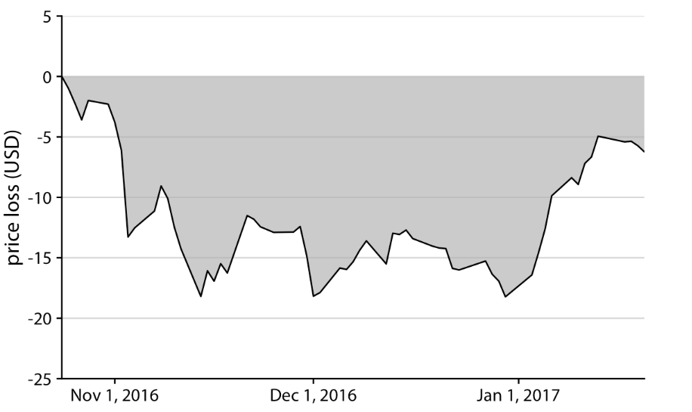
Not useful for small changes over the time?
The key is to select the appropriate reference point
Change in median income in Hawaiian counties from 2010 to 2015
Loss in Facebook (FB) stock price relative to the price of Oct. 22, 2016
Notes:
From the previous analysis, we can find that plotting from 0 can obscure the small changes over the time. Are the bar charts or area plots not useful for this purpose?
This is not the case:
It is perfectly valid to use bars or shaded areas to show differences between conditions, as long as we make it explicit which differences we are showing.
For example, we can use bars to visualize the change in median income in Hawaiian counties from 2010 to 2015, For all counties except Kalawao, this change amounts to less than $5000. (Kalawao is an unusual county, with fewer than 100 inhabitants, and it can experience large swings in median income from a small number of people moving into or out of the county.) And for Hawaii County, the change is negative, i.e., the median income in 2015 was lower than it was in 2010.
Similarly, we can draw the change in Facebook stock price over time as the difference from its temporary high point on Oct. 22, 2016

Slide 19
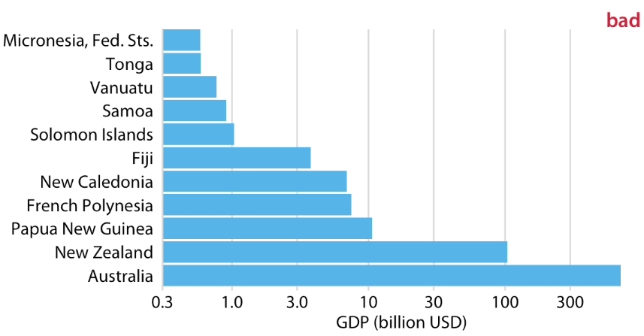
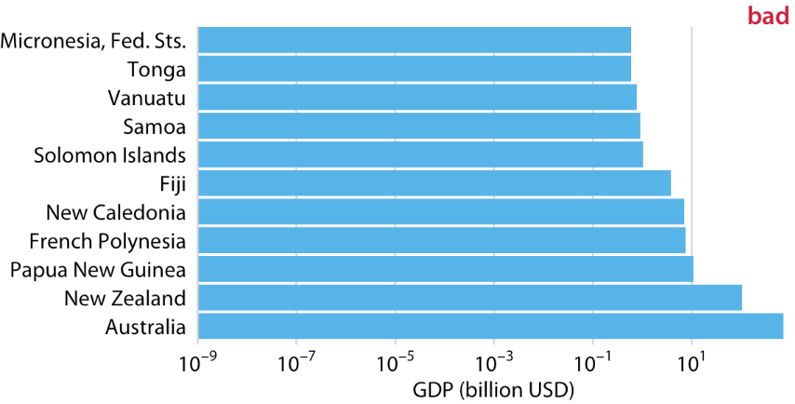
Visualizations along logarithmic axes
GDP in 2007 of countries in Oceania. The lengths of the bars do not accurately reflect the data values shown, since bars start at the arbitrary value of 0.3 billion USD.
GDP in 2007 of countries in Oceania. The lengths of the bars do not accurately reflect the data values shown, since bars start at the arbitrary value of 10⁻⁹ billion USD.
Notes:
Sometimes, it is not a good choice to use the linear scale to visualize data. Especially, there is large differences in quantities among data. For example, in the plot of comparing GDPs for different countries, in this figure New zealand and Australia are way larger than other countries. Visualizing those countries in a same graph, the graph will be dominated by the countries of New Zealand and Australia. You may think that we use logarithmic axes, but this time it is not the case.
As shown in the figure:
(1) the bar length does represent the GDP any more;
(2) We can not start the bars at 0, logarithm cannot incorporate 0. If the data incorporate 0, the logarithmic of the data will be infinite, so this is not really applicable.

Slide 20
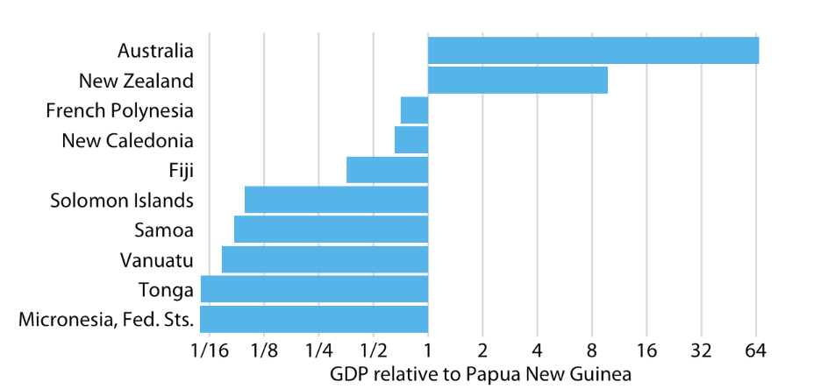
Visualizations along logarithmic axes
Bars on a logarithmic scale is a good choice for visualizing ratios
The GDP values of countries in Oceania VS those in Papua New Guinea
When bars are drawn on a log scale, they represent ratios and need to be drawn starting from 1, not 0.
Notes:
But the logarithmic scale is really a good choice for visualizing ratios.
This figure does a good job of highlighting the key relationships between GDPs of various countries, We can see that New Zealand has over eight times the GDP of Papua New Guinea and Australia over 64 times, while Tonga and the Federated States of Micronesia have less than one-sixteenth of the GDP of Papua New Guinea. French Polynesia and New Caledonia are close but have a slightly smaller GDPs than Papua New Guinea does.

Slide 21
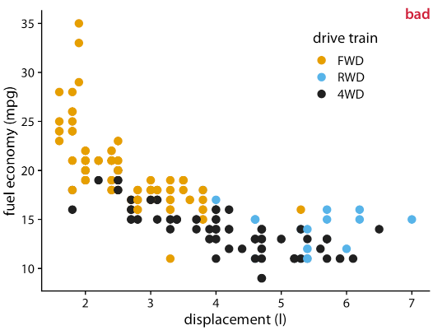
Handling overlapping points
Scenarios
21 cars with 2.0 liter engine displacement in four different economy values, incars which there are also 2 four-wheel
Fule economy and engine displacement for 234 popular car models released between 1999 and 2008
Notes:
The figure is labeled “bad” because many points are plotted on top of others and obscure them.
In this figure, there are 21 cars are represented by only four distinct points, so that 2.0 liter engines appear much less popular than they actually are.

Slide 22
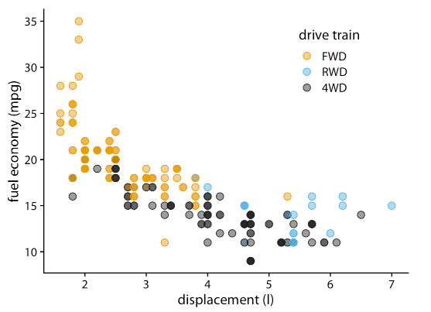
Handling overlapping points
Partial Transparency
Each individual point is partially transparent, then overlapped points appear as darker ones, as such the color of the points reflects the density of points in that location.
Some points are darker than others, but still difficult to estimate how many points were in the same location.
The differences in transparency are not self-explanatory.
Some “overplottings”, but do know how many
Notes:
One common strategy is to make these data points partially transparent.
however, making points partially transparent is not always sufficient to solve the issue of overplotting. For example, even though we can see in Figure 18.2 that some points have a darker shade than others, it is difficult to estimate how many points were plotted on top of each other in each location. In addition, while the differences in shading are clearly visible, they are not self-explanatory. A reader who sees this figure for the first time will likely wonder why some points are darker than others and will not realize that those points are in fact multiple points stacked on top of each other.

Slide 23
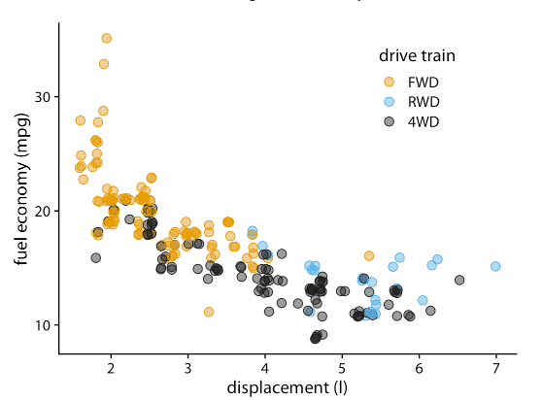
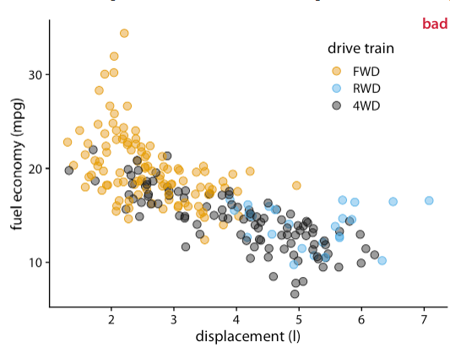
Handling overlapping points
Add some jiter
Notes:
Simple trick that helps in this situation is to apply a small amount of jitter to the points, i.e., to displace each point randomly by a small amount in either the x or the y direction or both. With jitter, it is immediately apparent that the darker areas arise from points that are plotted on top of each other. Also, now, for the first time the black dots representing four-wheel drive cars with 2.0-liter engines are clearly visible.
One downside of jittering is that it does change the data and therefore has to be performed with care. If we jitter too much, we end up placing points in locations that are not representative of the underlying dataset. The result is a misleading visualization of the data.

Slide 24
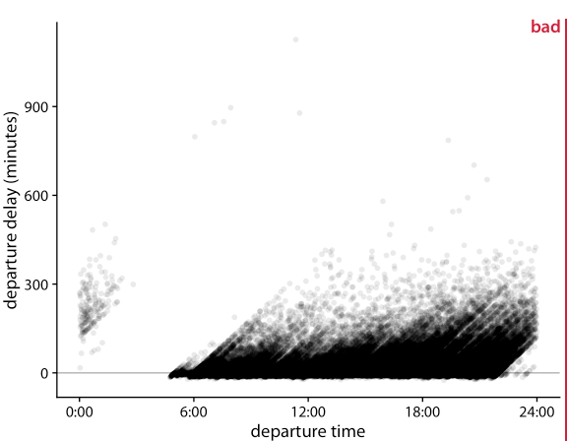
Handling overlapping points
2D histograms
Flights with significant delay more than 400 minutes were barely visible.
Did not provide information whether the flights are departure on time or with delay
Departure delay in minutes versus the flight departure time, for all flights departing Newark airport (EWR) in 2013. Each dot represents one departure.
Notes:
Sometimes, when data goes large, transparency and jitters cannot solve the problem.
This figure shows departure delays for over 100,000 individual flights, with each dot representing one flight departure.
Even though we have made the individual dots fairly transparent, the majority of them just forms a black band between 0 and 300 minutes departure delay.
This band obscures whether most flights depart approximately on time or with substantial delay (say 50 minutes or more). At the same time, the most delayed flights (with delays of 400 minutes or more) are barely visible due to the transparency of the dots.
This band obscures whether most flights depart approximately on time or with substantial delay (say 50 minutes or more). At the same time, the most delayed flights (with delays of 400 minutes or more) are barely

Slide 25
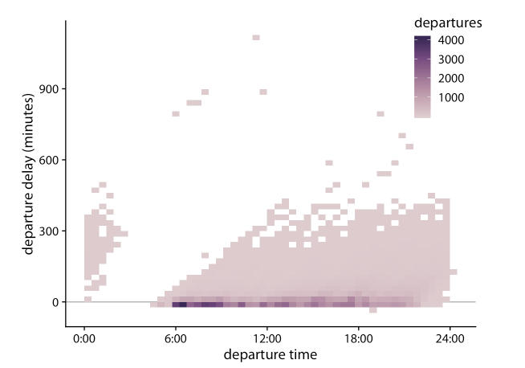
Handling overlapping points
2D histograms
Bin the data in two dimensions. We subdivide the entire x–y plane into small rectangles, count how many observations fall into each one, and then color the rectangles by that count.
Longer delays if departure late
Most flights depart between 6.00 to 9.00, do not delay event depart early.
Departure delay in minutes versus the flight departure time. Each colored rectangle represents all flights departing at that time with that departure delay. Coloring represents the number of flights represented by that rectangle.

Slide 26
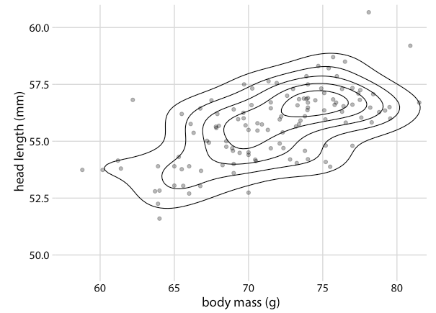
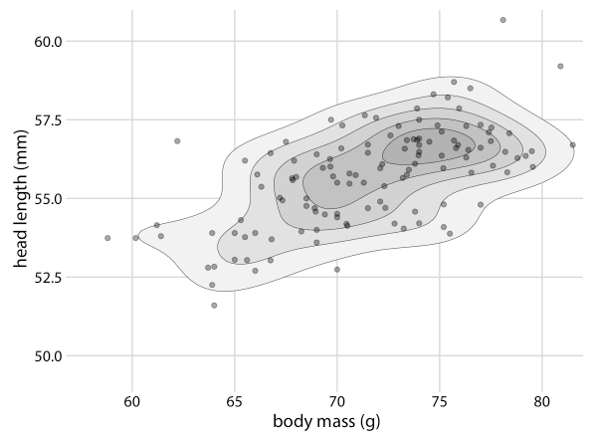
Handling overlapping points
Contour lines
Head length versus body mass for 123 blue jays
Head length versus body mass for 123 blue jays, with the areas enclosed by the contour lines are shaded with increasingly darker shades of gray
Notes:
we can also estimate the point density across the plot area and indicate regions of different point densities with contour lines. This technique works well when the point density changes slowly across both the x and the y dimensions. Each dot corresponds to one bird, and the lines indicate regions of similar point density. The point density increases towards the center of the plot, near a body mass of 75g and a head length between 55mm and 57.5mm.
This shading creates a stronger visual impression of increasing point density towards the center of the point cloud.

Slide 27
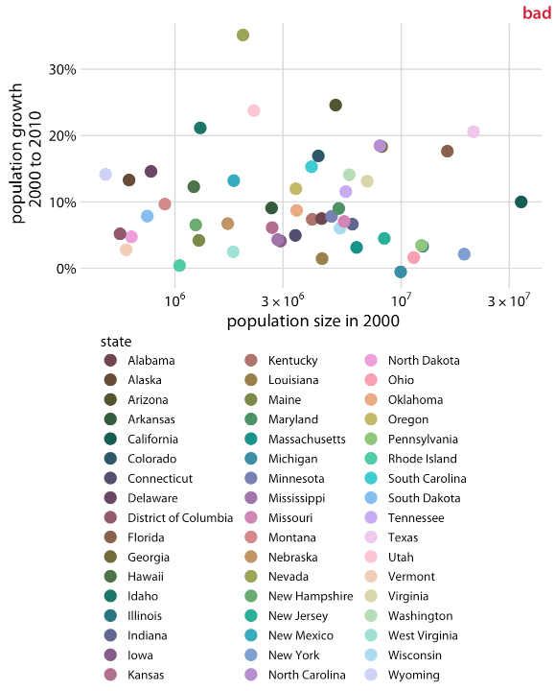
Pitfalls of color use
Encoding too much or irrelevant information
We should use color to enhance figures and make them easier to read, not to obscure the data by creating visual puzzles
Population growth from 2000 to 2010 versus population size in 2000, for all 50 U.S. states and the Discrict of Columbia.
Notes:
There are simply too many different colors, and many of them are quite similar to each other.
Even if with a lot of effort we can figure out exactly which state is which, this visualization defeats the purpose of coloring.

Slide 28
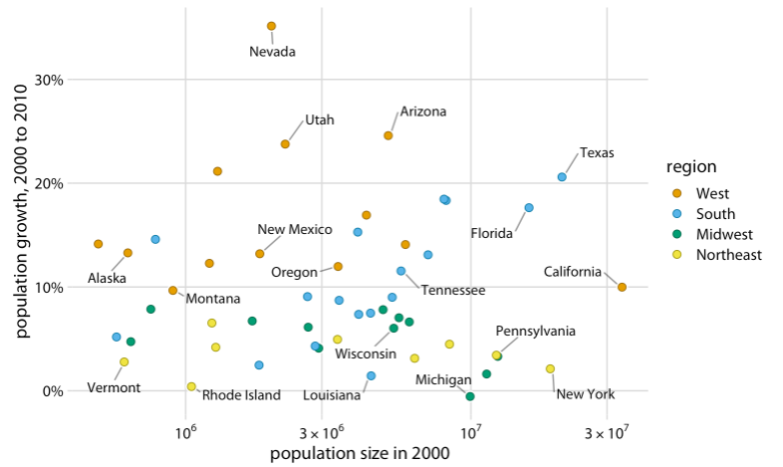
Pitfalls of color use
Using colors to encode regions, and using text to indicate the specific states
Qualitative color scales work best when there are three to five different categories that need to be colored.
Use direct labeling instead of colors when you need to distinguish between more than about eight categorical items.
Population growth from 2000 to 2010 versus population size in 2000
Notes:
So one way to address this issue is to use color to encode regions of the states and use text to indicate the name of the states

Slide 29
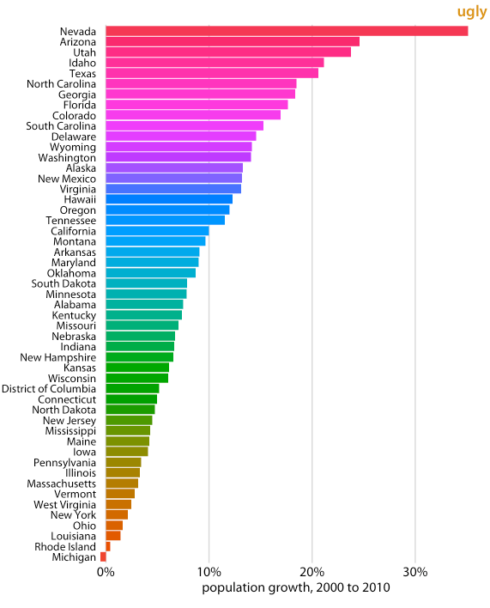
Pitfalls of color use
Coloring for the sake of coloring
Avoid large filled areas of overly saturated colors. They make it difficult for your reader to carefully inspect your figure.
The color is interesting but does not highlight information we want to share and create any new insights.
The chosen colors are too saturated and intense. This color intensity makes the figure difficult to look at.
Notes:
Give each bar its own color to create a rainbow effect. This may look like an interesting visual effect, but it is not creating any new insight into the data or making the figure easier to read.
For example, it is difficult to read the names of the states without having our eyes drawn to the large, strongly colored areas right next to the state names. Similarly, it is difficult to compare the endpoints of the bars to the underlying grid lines.

Slide 30
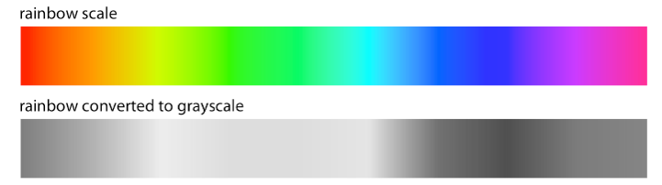
Pitfalls of color use
Using non-monotonic color scales to encode data values
Two principles of using color scales to encode data:
The colors need to clearly indicate which data values are larger or smaller than which other ones
The differences between colors need to visualize the corresponding differences between data values
Notes:
The most popular such scale is the rainbow scale (Figure 19.4). It runs through all possible colors in the color spectrum. This means the scale is effectively circular; the colors at the beginning and the end are nearly the same (dark red). If these two colors end up next to each other in a plot, we do not instinctively perceive them as representing data values that are maximally apart. In addition, the scale is highly non-monotonic. It has regions where colors change very slowly and others when colors change rapidly. This lack of monotonicity becomes particularly apparent if we look at the color scale in grayscale (Figure 19.4). The scale goes from medium dark to light to very dark and back to medium dark, and there are large stretches where lightness changes very little followed by relatively narrow stretches with large changes in lightness.

Slide 31
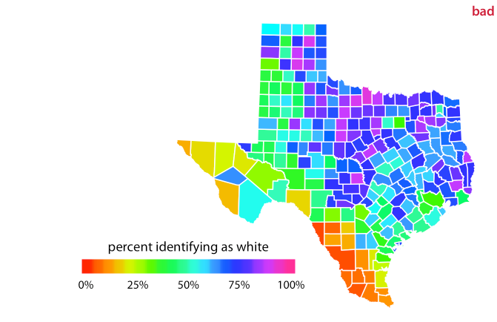
Pitfalls of color use
Using non-monotonic color scales to encode data values
Percentage of people identifying as white in Texas counties. The rainbow color scale is not an appropriate scale to visualize continuous data values, because it tends to place emphasis on arbitrary features of the data. Here, it emphasizes counties in which approximately 75% of the population identify as white.
Notes:
In a visualization of actual data, the rainbow scale tends to obscure data features and/or highlight arbitrary aspects of the data (Figure 19.5). As an aside, the colors in the rainbow scale are also overly saturated. Looking at Figure 19.5 for any extended period of time can be quite uncomfortable.

Slide 32
Multi-panel Figures
Two distinct categories of multipanel figures:
Small multiples: multiple panels arranged in a regular grid, each panel shows a different subset of the data but all panels use the same type of visualization.
Compound figures: consist of separate figure panels assembled in an arbitrary arrangement (which may or may not be grid based) and showing entirely different visualizations, or possibly even different datasets.

Slide 33
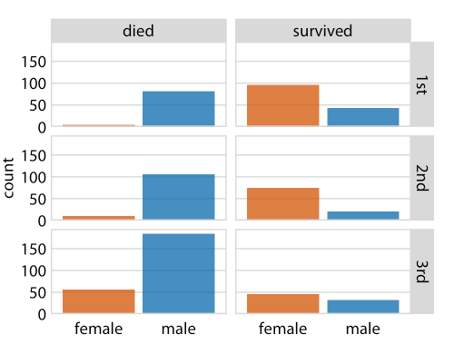
Multi-panel Figures
Small multiples
We subdivide the titanic data based on the class of passengers, and further subdivided each class by survive or not. In each figure, we compare the number of female and male passengers.
All the subfigures are the same type of visualization.
Notes:
This visualization provides an intuitive and highly interpretable visualization of the fate of the Titanic passengers. We see clearly that most men died and most women survived. Further, and among the women who died nearly all were traveling in 3rd class.

Slide 34
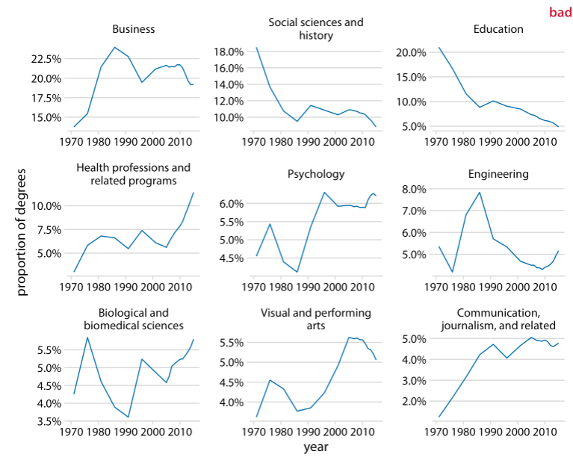
Multi-panel Figures
The panels in the figure should use the same ranges and scalings, because our human mind expects this to be the case.
Notes:
For example, consider Figure 21.3, which presents how the proportion of Bachelor’s degrees in different degree areas has changed over time. The figure shows the nine degree areas that have represented, on average, more than 4% of all degrees between 1971 to 2015. The y axis of panel is scaled such that the curve for each degree field covers the entire y-axis range. As a consequence, a cursory examination of Figure 21.3 suggests that the nine degree areas are all equally popular and have all experienced variation in popularity of a similar magnitude.

Slide 35
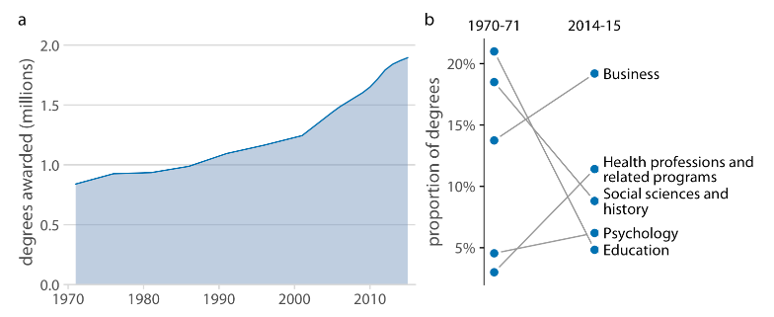
Multi-panel Figures
Compound figures
Combining different types of figures into a large figure to convey one overarching point.
Trends in Bachelor’s Degrees conferred by U.S. institutions of higher learning. (a) From 1970 to 2015, the total number of degrees nearly doubled. (b) Among the most popular degree areas, social sciences, history, and education experienced a major decline, while business and health professions grew.
Notes:
Not every figure with multiple panels fits the pattern of small multiples. Sometimes we simply want to combine several independent panels into a combined figure that conveys one overarching point. In this case, we can take the indivdiual plots and arrange them in rows, columns, or other, more complex arrangements, and call the entire arrangement one figure.

Slide 36
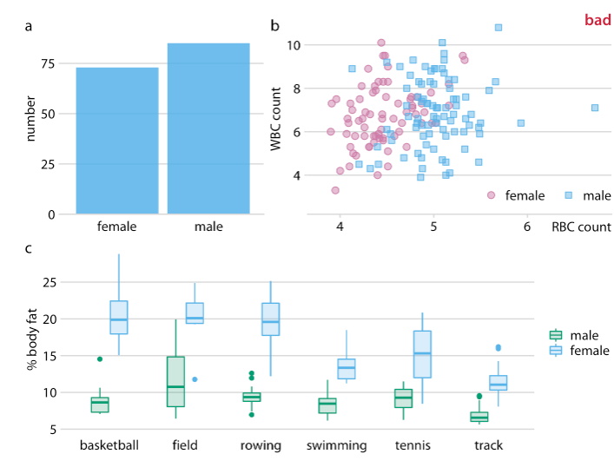
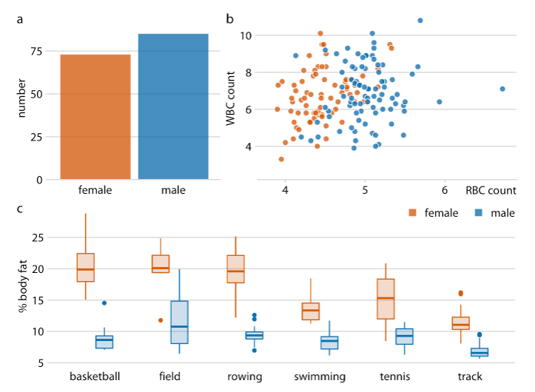
Multi-panel Figures
Compound figures
What is Bad?
Physiology and body-composition of male and female athletes

Slide 37
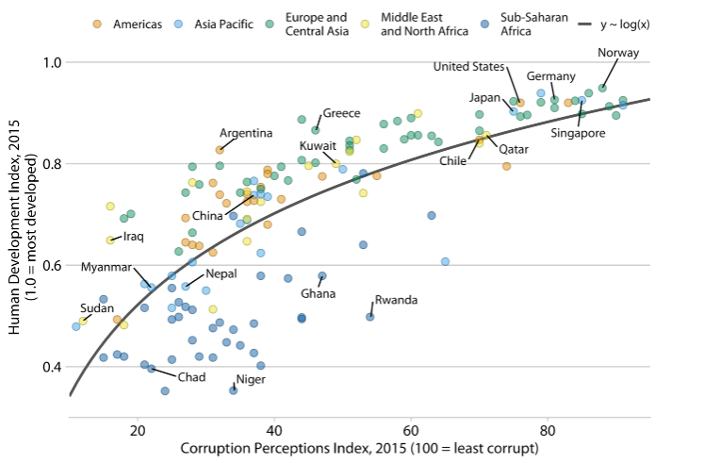
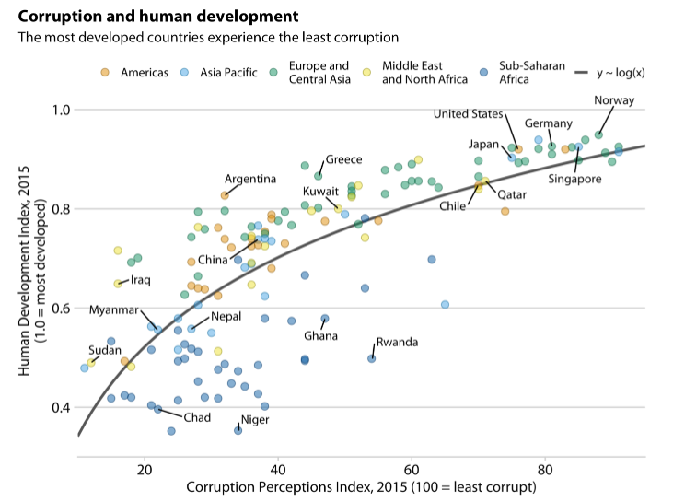
Titles, captions, and tables
Title integrated into the main display
Figure titles and captions
Corruption and human development: The most developed countries experience the least corruption.
Notes:
A data visualization is not a piece of art meant to be looked at only for its aesthetically pleasing features. Instead, its purpose is to convey information and make a point. To reliably achieve this goal when preparing visualizations, we have to place the data into context and provide accompanying titles, captions, and other annotations.
Every figure needs the title. The job of the title is to accurately convey to the reader what the figure is about, what point it makes.

Slide 38
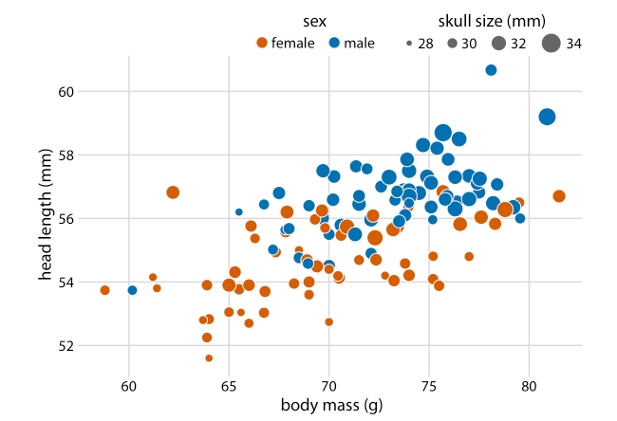
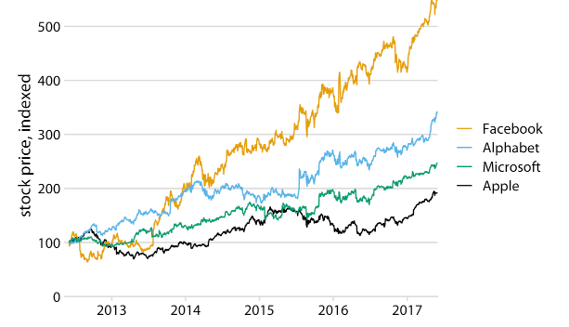
Titles, captions, and tables
Axis and legend titles
Legend title
Omitted
Head length versus body mass for 123 blue jays

Slide 39
Directory of visualizations
Amounts
Distributions
Proportions
X-y relationships
Geospatial data
Uncertainty

Slide 40


Amounts
Visualizing amounts from one category
Visualizing amounts from multiple categories
Notes:
The most common approach to visualizing amounts (i.e., numerical values shown for some set of categories) is using bars, either vertically or horizontally arranged (Chapter 6). However, instead of using bars, we can also place dots at the location where the corresponding bar would end (Chapter 6).
If there are two or more sets of categories for which we want to show amounts, we can group or stack the bars (Chapter 6). We can also map the categories onto the x and y axis and show amounts by color, via a heatmap (Chapter 6).

Slide 41

Distributions
Visualizing one distribution
Intuitive but require arbitrary parameter choices and can be misleading
Cumulative densities and quantile-quantile (q-q) plots represent the data faithfully but difficult to interpret

Slide 42

Distributions
Visualizing multiple distribution
Overall shifts among distributions in multiple distributions
Stacked plot and overlapping densities are useful for in-depth comparison of smaller number of distributions
Ridgeline plots are useful for large numbers of distributions
Notes:
Boxplots, violins, strip charts, and sina plots are useful when we want to visualize many distributions at once and/or if we are primarily interested in overall shifts among the distributions
Stacked histograms and overlapping densities allow a more in-depth comparison of a smaller number of distributions, though stacked histograms can be difficult to interpret and are best avoided
Ridgeline plots can be a useful alternative to violin plots and are often useful when visualizing very large numbers of distributions or changes in distributions over time

Slide 43


Proportions
Single set of proportion
Multiple sets of proportions

Slide 44

Distributions
Mosaic plots assume that every level of one grouping variable can be combined with every level of another grouping variable, whereas treemaps do not make such an assumption.
Treemaps work well even if the subdivisions of one group are entirely distinct from the subdivisions of another.
Parallel sets work better than either mosaic plots or treemaps when there are more than two grouping variables.

Slide 45

X–y relationships
Relationships between two variables
Mapping one variable into size with three variables
X, y variables are measured with the same units
X, y variables connected by straight lines
Notes:
Scatterplots represent the archetypical visualization when we want to show one quantitative variable relative to another (Chapter 12.1). If we have three quantitative variables, we can map one onto the dot size, creating a variant of the scatterplot called bubble chart. For paired data, where the variables along the x and the y axes are measured in the same units, it is generally helpful to add a line indicating x = y (Chapter 12.4). Paired data can also be shown as a slope graph of paired points connected by straight lines (Chapter 12.4).

Slide 46


X–y relationships
Notes:
For large numbers of points, regular scatterplots can become uninformative due to overplotting. In this case, contour lines, 2D bins, or hex bins may provide an alternative (Chapter 18). When we want to visualize more than two quantities, on the other hand, we may choose to plot correlation coefficients in the form of a correlogram instead of the underlying raw data
When the x axis represents time or a strictly increasing quantity such as a treatment dose, we commonly draw line graphs (Chapter 13). If we have a temporal sequence of two response variables, we can draw a connected scatterplot where we first plot the two response variables in a scatterplot and then connect dots corresponding to adjacent time points (Chapter 13.3). We can use smooth lines to represent trends in a larger dataset (Chapter 14).

Slide 47

Geospatial data
Notes:
The primary mode of showing geospatial data is in the form of a map (Chapter 15). A map takes coordinates on the globe and projects them onto a flat surface, such that shapes and distances on the globe are approximately represented by shapes and distances in the 2D representation. In addition, we can show data values in different regions by coloring those regions in the map according to the data. Such a map is called a choropleth (Chapter 15.3). In some cases, it may be helpful to distort the different regions according to some other quantity (e.g., population number) or simplify each region into a square. Such visualizations are called cartograms.

Slide 48

Uncertainty
Error bars are graphical representations of variability of data and used on graphs to indicate the error or uncertainty in a reported measurement.
Error bars often represent one standard deviation of uncertainty, one standard error, or a particular confidence interval.
A short Error Bar shows that values are concentrated, a long Error Bar would indicate that the values are more spread out and less reliable
Notes:
Error bars are meant to indicate the range of likely values for some estimate or measurement. They extend horizontally and/or vertically from some reference point representing the estimate or measurement (Chapter 16). Reference points can be shown in various ways, such as by dots or by bars. Graded error bars show multiple ranges at the same time, where each range corresponds to a different degree of confidence. They are in effect multiple error bars with different line thicknesses plotted on top of each other.
The length of an Error Bar helps reveal the uncertainty of a data point: a short Error Bar shows that values are concentrated, signalling that the plotted average value is more likely, while a long Error Bar would indicate that the values are more spread out and less reliable.
Also depending on the type of data, the length of each pair of Error Bars tend to be of equal length on both sides. However, if the data is skewed, then the lengths on each side would be unbalanced.

Slide 49


Uncertainty
Notes:
To achieve a more detailed visualization than is possible with error bars or graded error bars, we can visualize the actual confidence or posterior distributions (Chapter 16). Confidence strips provide a clear visual sense of uncertainty but are difficult to read accurately. Eyes and half-eyes combine error bars with approaches to visualize distributions (violins and ridgelines, respectively), and thus show both precise ranges for some confidence levels and the overall uncertainty distribution. A quantile dot plot can serve as an alternative visualization of an uncertainty distribution (Chapter 16.1). By showing the distribution in discrete units, the quantile dot plot is not as precise but can be easier to read than the continuous distribution shown by a violin or ridgeline plot.
For smooth line graphs, the equivalent of an error bar is a confidence band (Chapter 16.3). It shows a range of values the line might pass through at a given confidence level. As in the case of error bars, we can draw graded confidence bands that show multiple confidence levels at once. We can also show individual fitted draws in lieu of or in addition to the confidence bands.

Slide 50
Visualization Packages

Slide 51


Matplotlib VS Seaborn

Slide 52

Reference Book
https://clauswilke.com/dataviz/

